Slide 1

International Islamic University Chittagong
Data Structure Project Presentation Slide (3rd Semester)
Course Code: CSE-2322
Project Name: Dictionary using Binary Search Tree (BST)
Group Name: Code_Crafters
Team Members:
1. Mohammad Tanim Tahmid ; ID: C223130
2. Minhaz Ahmmed ; ID: C231011
3. Ayman Abrar ; ID: C231001

Slide 2
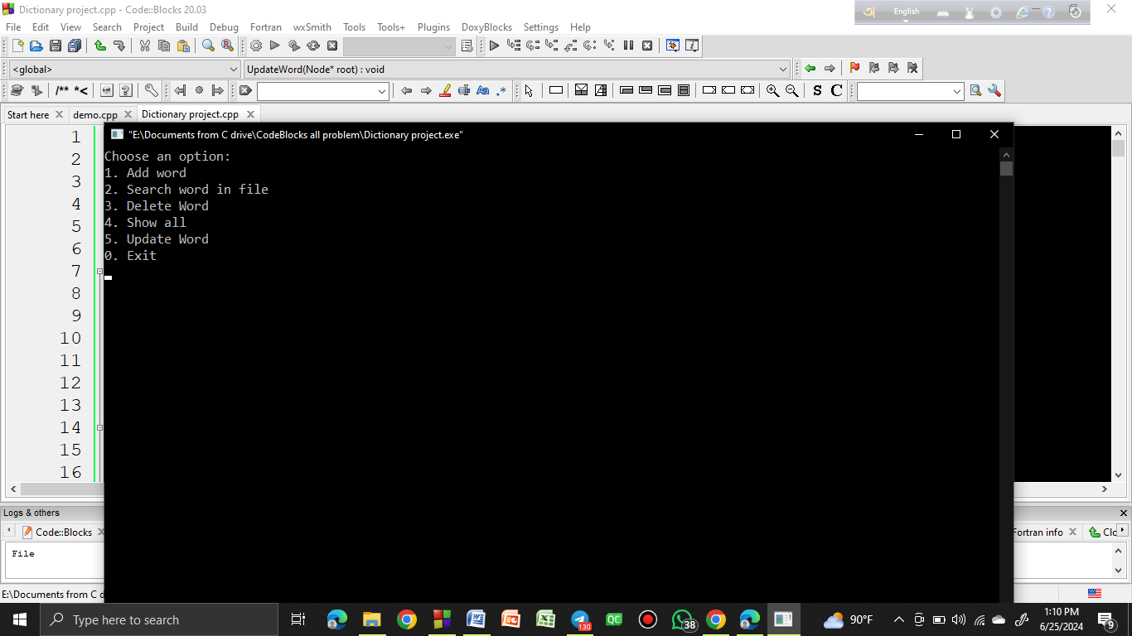
Main menu:
In main menu there has total 5 options. They are: 1) Add word 2) Search word in file 3) Delete word 4) Show all 5) Update word and then Exit option.

Slide 3

Add Word:
In add word option we can add words with their meanings. After adding words those will save in our project database.

Slide 4
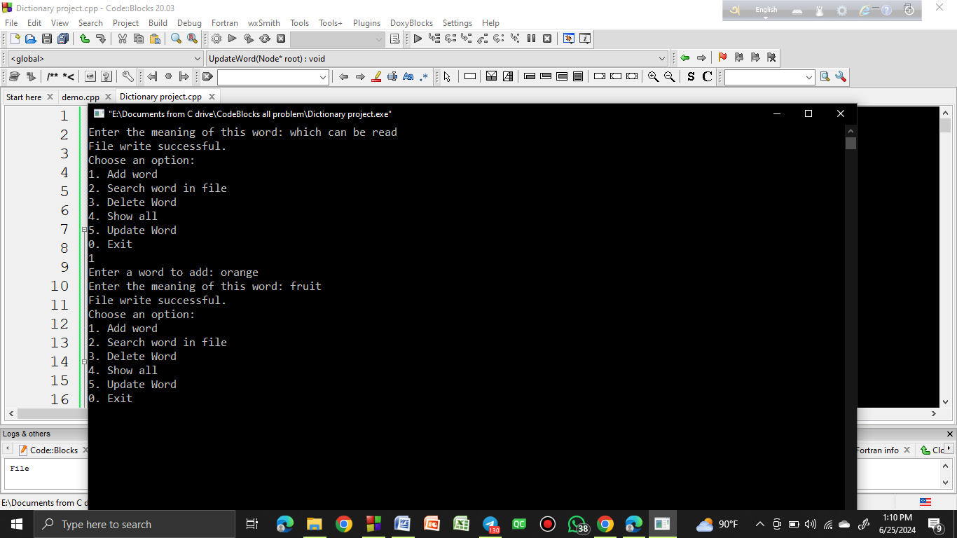
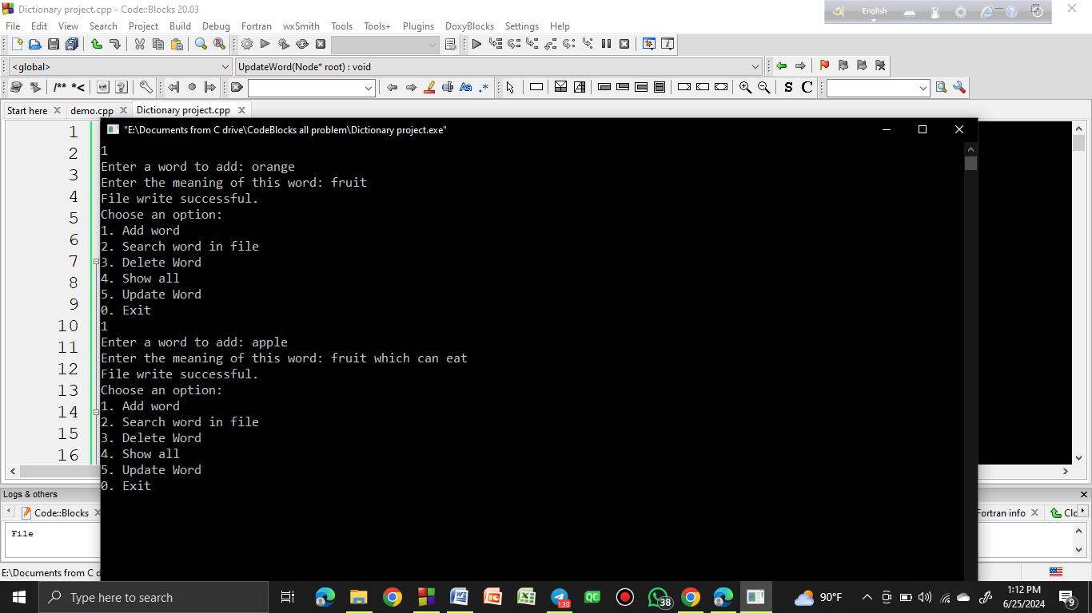

Slide 5
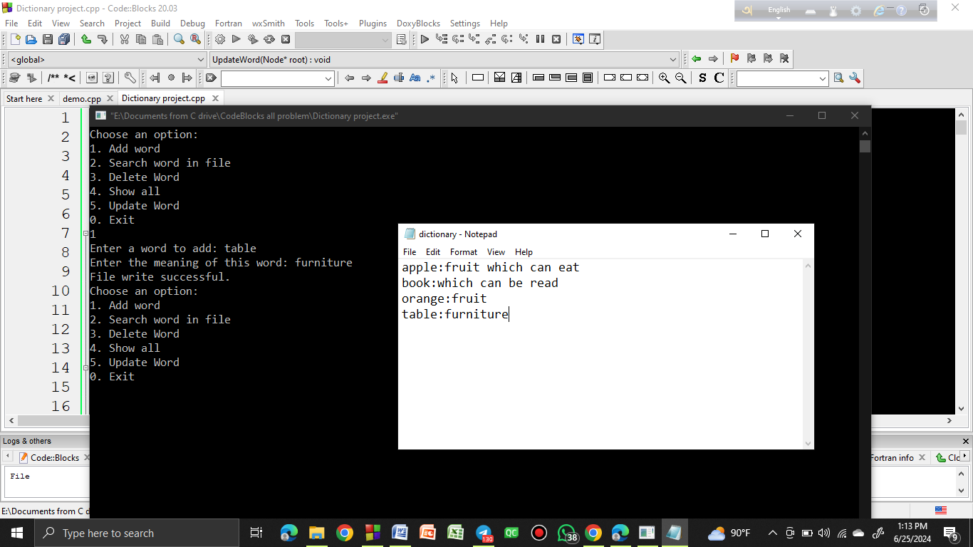
Database after adding words:
After adding those words it will save our project database. Here’s our database file.

Slide 6

Search word in file:
We can search any words with their meanings from this option.

Slide 7


Slide 8
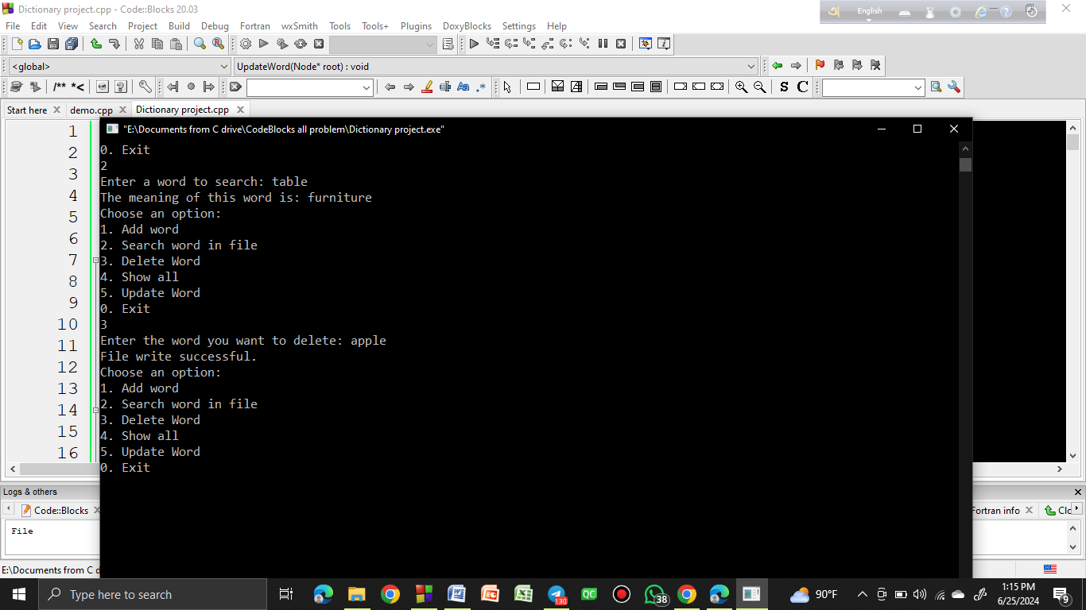
Delete word:
We can delete any words from this option.

Slide 9


Slide 10

Database after deleting word:
Here’s our database file after delete words.

Slide 11

Show all:
We can see our full database file from this option.

Slide 12
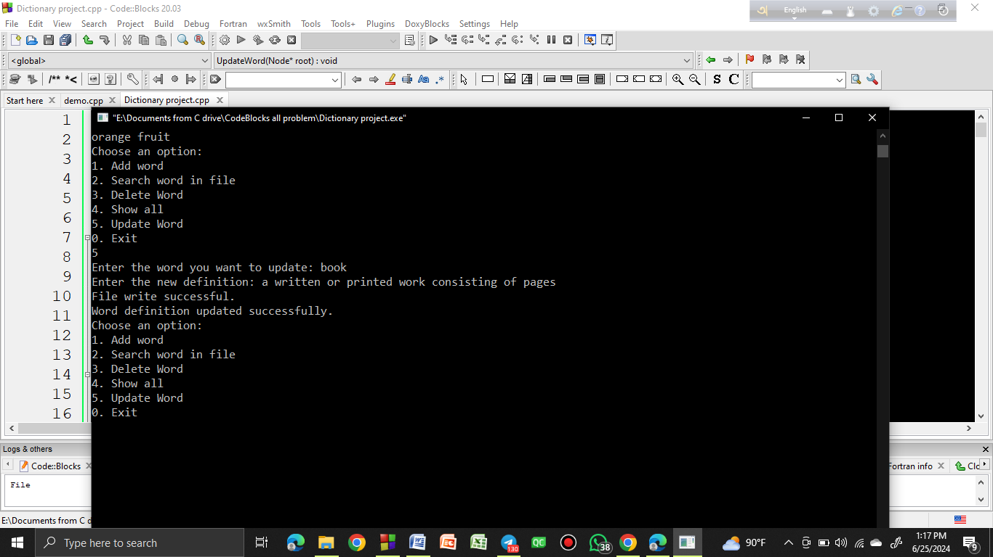
Update words:
We can update the meaning of words from this option.

Slide 13
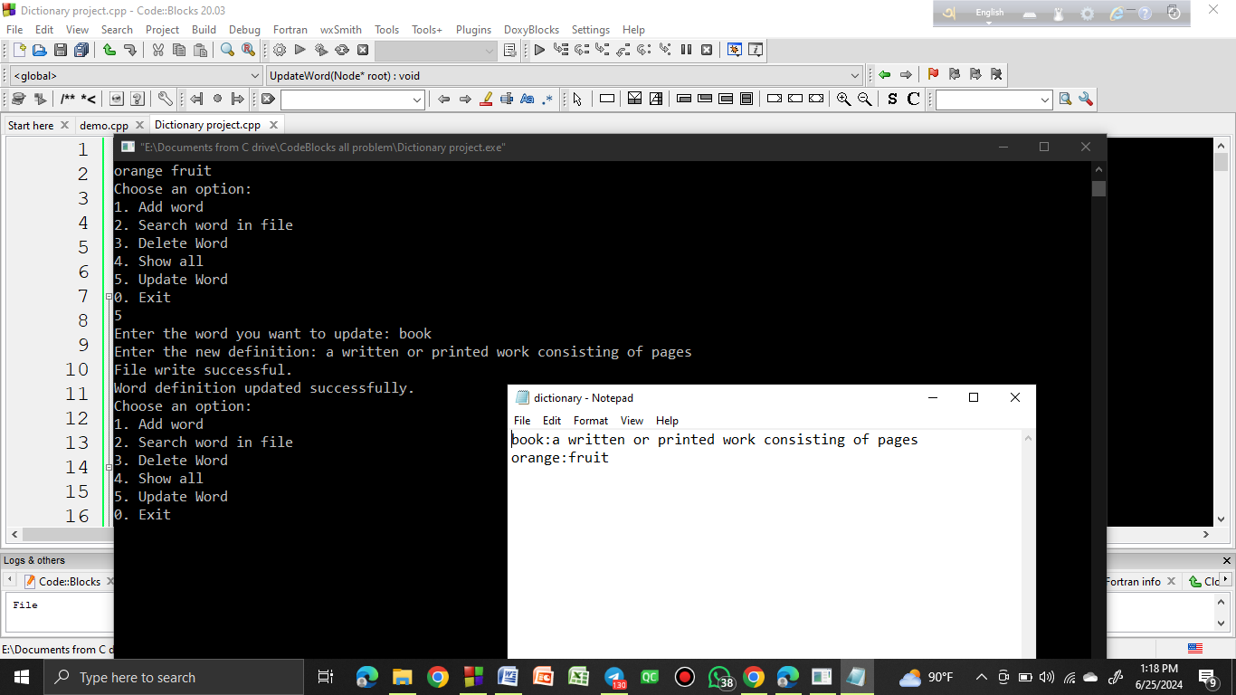
Database file after updating words:
Here’s our database file after updating words.

Slide 14
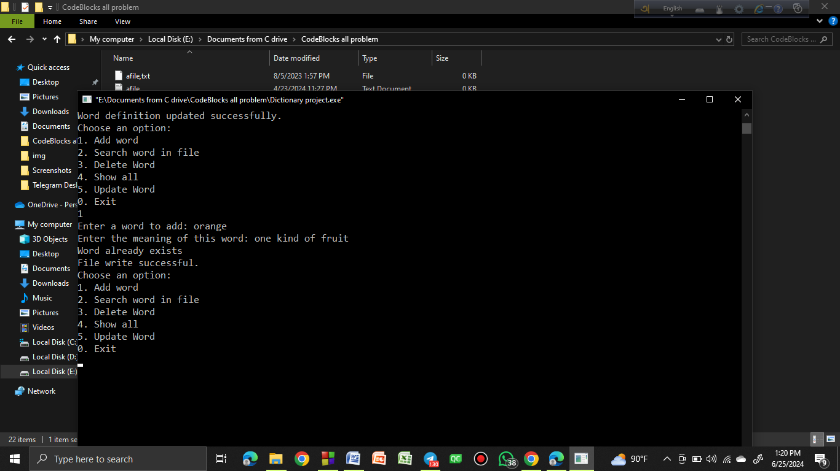
Those functions are otherwise or else functions:
Add word: We can’t added same word two times. This will show a message: “Word already exists.”

Slide 15
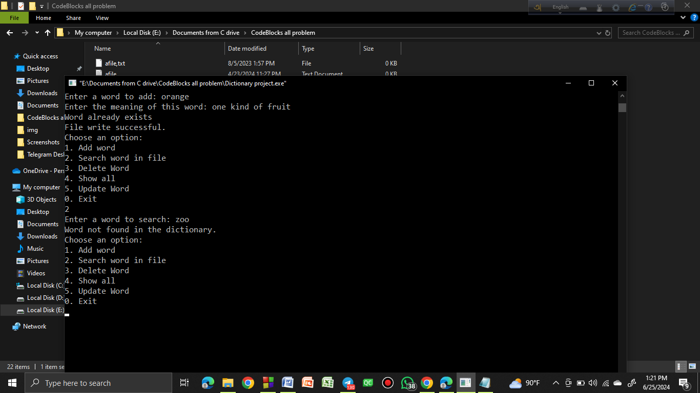
Those functions are otherwise or else functions:
Search word: We can’t search those words which not present in file. This will show a message: “Word not found in the dictionary.”

Slide 16
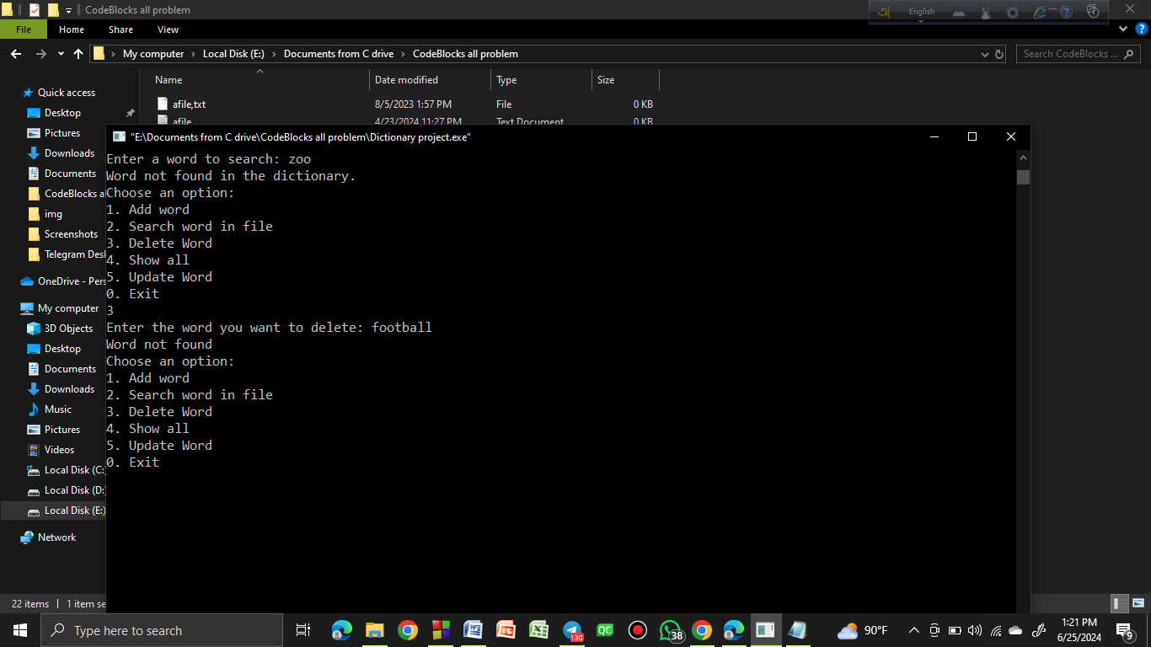
Those functions are otherwise or else functions:
Delete word: We can’t delete those words which not present in file. This will show a message: “Word not found.”

Slide 17
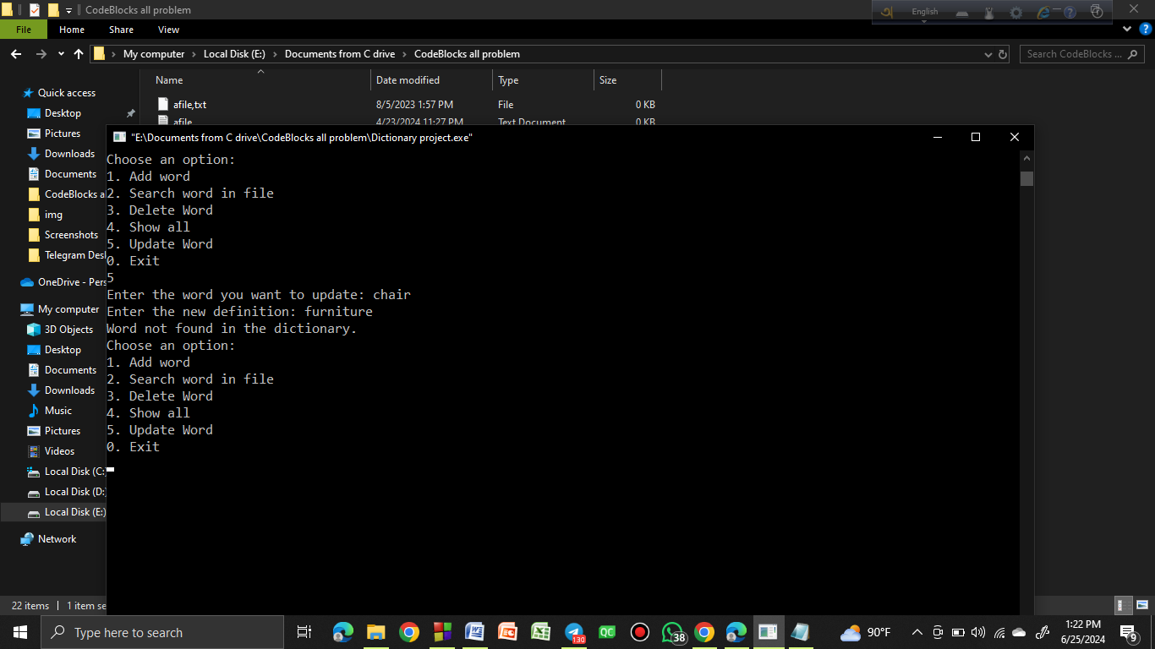
Those functions are otherwise or else functions:
Update word: We can’t update those words which not present in file. This will show a message: “Word not found in the dictionary.”

Slide 18
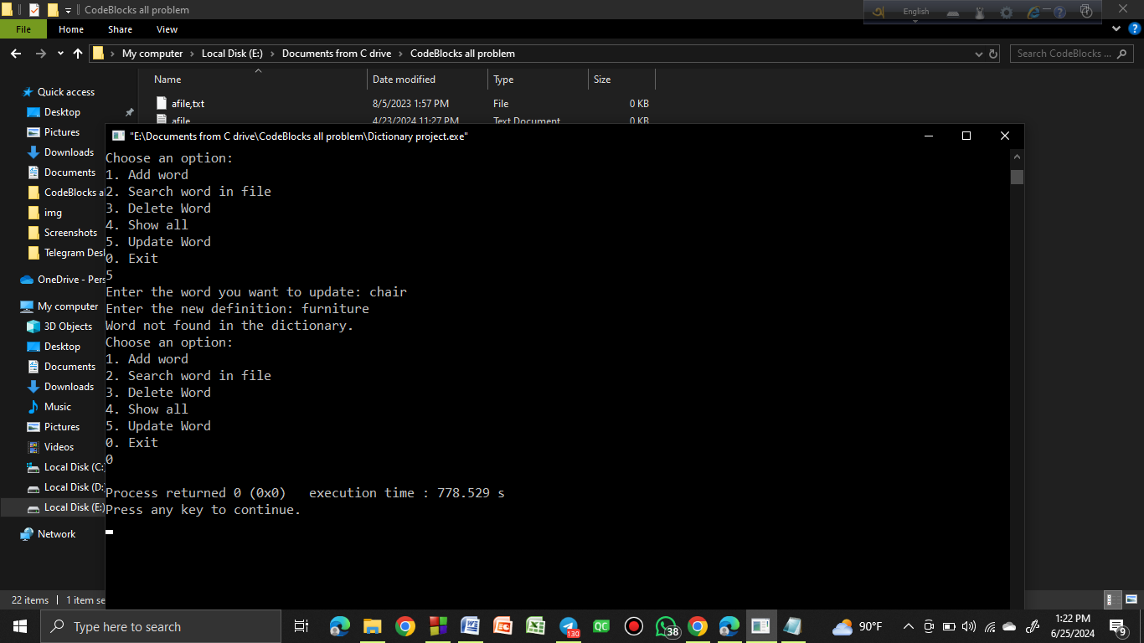
Exit or close the program:
If we press 0 and then press Enter button it will close the program.

Slide 19
Thank You

